Slide 1



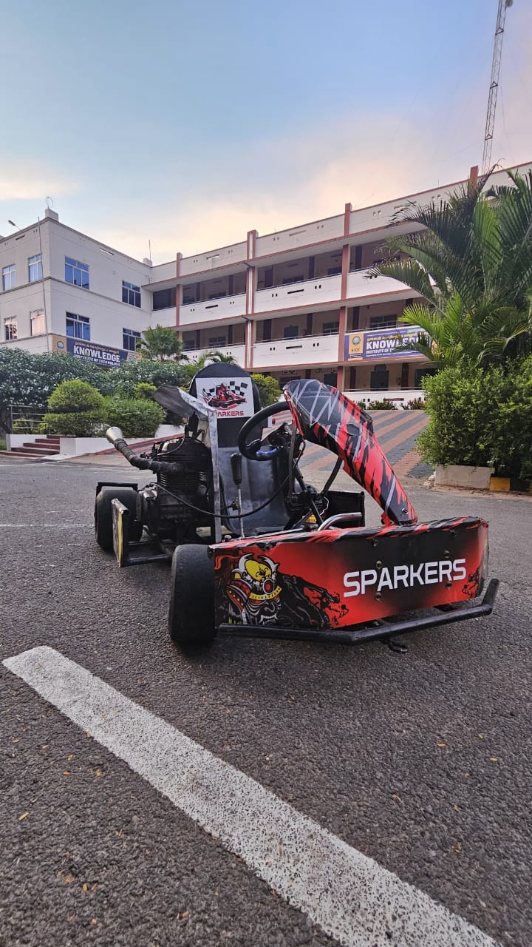

KARTING ENDURANCE CHAMPIONSHIP Organized by ACADEMY OF INDIGENOUS MOTOR SPORTS Powered By (ACADEMY OF INDIGENOUS MOTOR SPORTS,EDUCATIONAL & SOCIAL WELFARE TRUST) (Registered Trust)
Season-05
TEAM NAME : SPARKERS
TEAM VIN NO : 25KECCV15002
COLLEGE NAME : KNOWLEDGE INSTITUTE OF TECHNOLOGY
ENGINE CATEGORY : 150cc
FUEL SYSTEM : CARBURETOR
Notes:
Vehicle 3-D image

Slide 2
TEAM COMPOSITION AND WORK ALLOCATION
SI. NO | NAME | DESIGNATION
1 | PRADEEP M | CAPTAIN
2 | SAKTHIVEL V | VICE CAPTAIN
3 | PRITHIV RAJ V | DRIVER
4 | SEENIVASAN R | DRIVER
5 | ANISH C [H] | CHASIS AND FABRICATION
6 | KARTHI V S | CHASIS AND FABRICATION
7 | VEERAMANI K | CHASIS AND FABRICATION
8 | GOKUL RAMANA D | CHASIS AND FABRICATION
9 | DHARANEESH R | CHASIS AND FABRICATION
10 | DINESH KUMAR G | CHASIS AND FABRICATION
11 | DHANUSH R [H] | POWER TRAIN
12 | HARISH A | POWER TRAIN
13 | LINGESHWARAN K M | POWER TRAIN
14 | TAMIL SELVAN E | POWER TRAIN
15 | SURYAPRAKASH K | POWER TRAIN
16 | KARTHICK S S [H] | STEERING
SI. NO | NAME | DESIGNATION
17 | SHARAN G | STEERING
18 | JAGADEESWARAN K | STEERING
19 | LOGANATHAN K | STEERING
20 | GOKULNATH S [H] | BRAKE
21 | VIVIN B K | BRAKE
22 | PREM KUMAR G | BRAKE
23 | RAMASAMY S A | BRAKE
24 | HARJENDRA D S [H] | DESIGN
25 | GURU PRASANNA V | DESIGN
26 | PRAKASH K | DESIGN
27 | ARAVINTH R | DESIGN
28 | RAJENDRA HARI PRASATH S [H] | SPARE MANAGEMENT
29 | SURENDHAR | SPARE MANAGEMENT
30 | VEERARAGHAVAN A | TOOL MANAGEMENT
31 | VIJAY R | TOOL MANAGEMENT

Slide 3
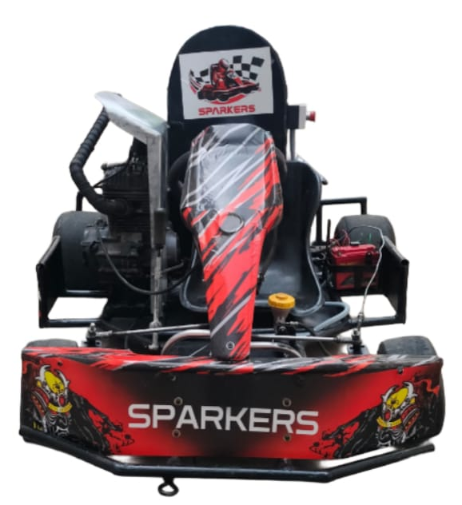
ABSTRACT
Go-karting is a popular motorsport that involves small, open-wheel, four-wheeled vehicles called go-karts. These vehicles are designed for recreational and competitive racing, offering an entry-level experience for aspiring racers. Go-karts are typically powered by either gasoline or electric engines and come in various types, from recreational rental karts to high-performance racing models used in professional competitions. This study explores the design, construction, and performance optimization of a go-kart, focusing on key aspects such as chassis design, aerodynamics, braking system, and engine efficiency. Safety considerations, including roll bars, seat belts, and driver gear, are also analyzed. The goal of this research is to enhance go-kart performance while maintaining cost-effectiveness and safety standards.

Slide 4
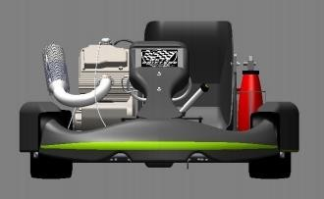
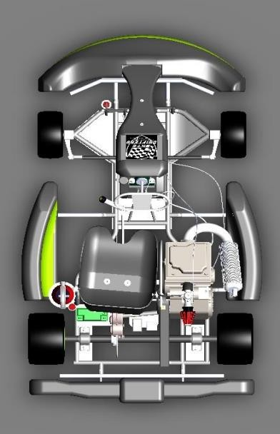
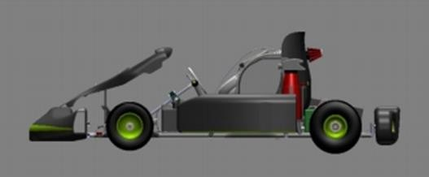
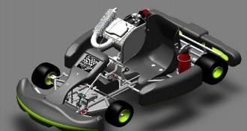
TECHNICAL SPECIFICATIONS AND 3D VIEWS
TECHNICAL SPECIFICATION | RESPECTIVE VALUES
Overall Dimensions | Length : 55 inches Width : 45 inches
Track Width | Small : 49.5 inches Large : 49.75 inches
Wheel Base | 40 inches
Tire Size | Front : 10 X 4.7 X 5 in Rear : 11 X 7.1 X 5 in
Ground Clearance | 2 inches
Centre of Gravity | 19.32(from left side) 26.62(from front side)
Maximum Speed | 70 Km/hr
Maximum Acceleration | 5.88 m/s²
Stopping Distance | 31.11 m
Weight | 170 Kg
Break Type | Disc
Fig. Front View
Fig. Side View
Fig. Top View
Fig. Isometric View

Slide 5
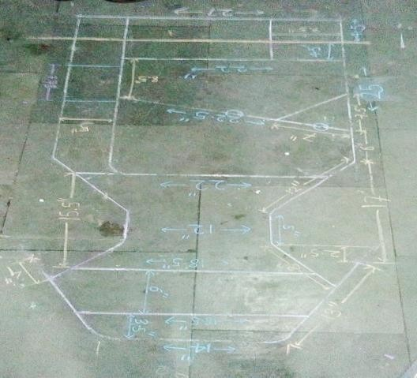
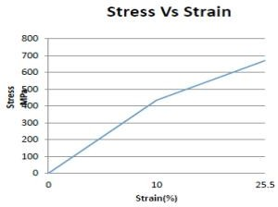
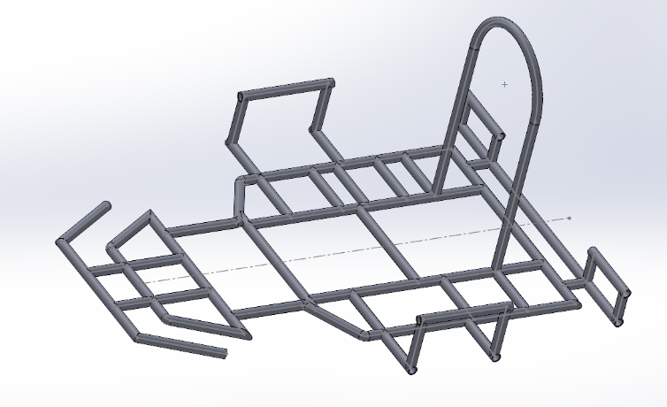
DESIGN METHODOLOGY & OVERALL PERFORMANCE TARGET
Properties | AISI 1018 | AISI 4130 | AISI 1026
Density (gm/cm²) | 7.8 | 7.8 | 7.8
Elasticity (GPa) | 210 | 210 | 210
Elongation % | 18-29 | 18-26 | 17-27
Strength to weight ratio (KNm/Kg) | 55-60 | 72-133 | 60-68
Thermal expansion (цm/mK) | 11.9 | 11.8 | 11.9
UTS (MPa) | 430-470 | 560-1040 | 470-530
Yield Strength (MPa) | 240-400 | 435-980 | 415-450
Fig. : Characteristic curve for AISI 4130
Roll Cage Mass | 22kg
Inner Diameter | 21.25 mm
Outer Diameter | 25.4 mm
Thickness | 2.075 mm

Slide 6
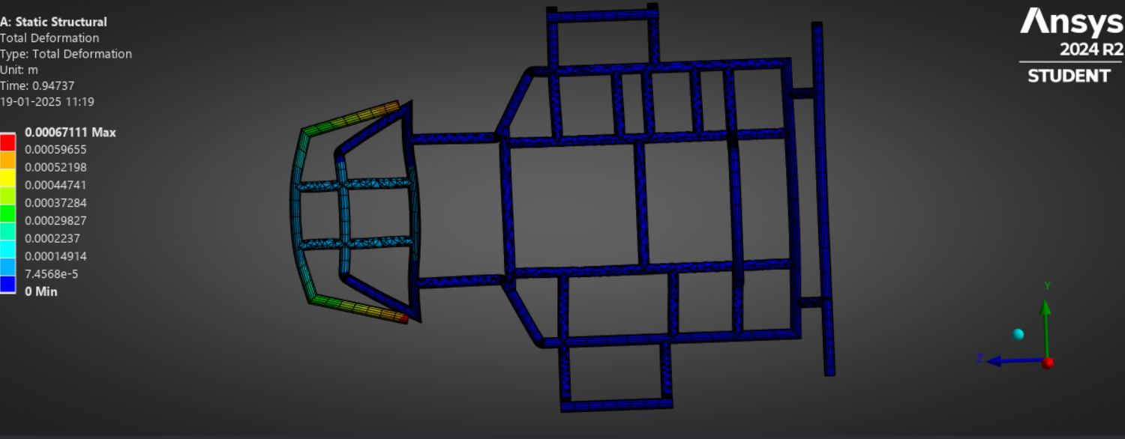
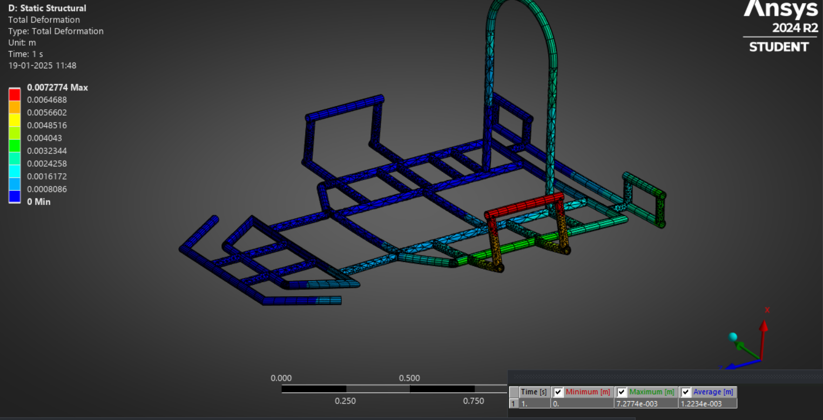
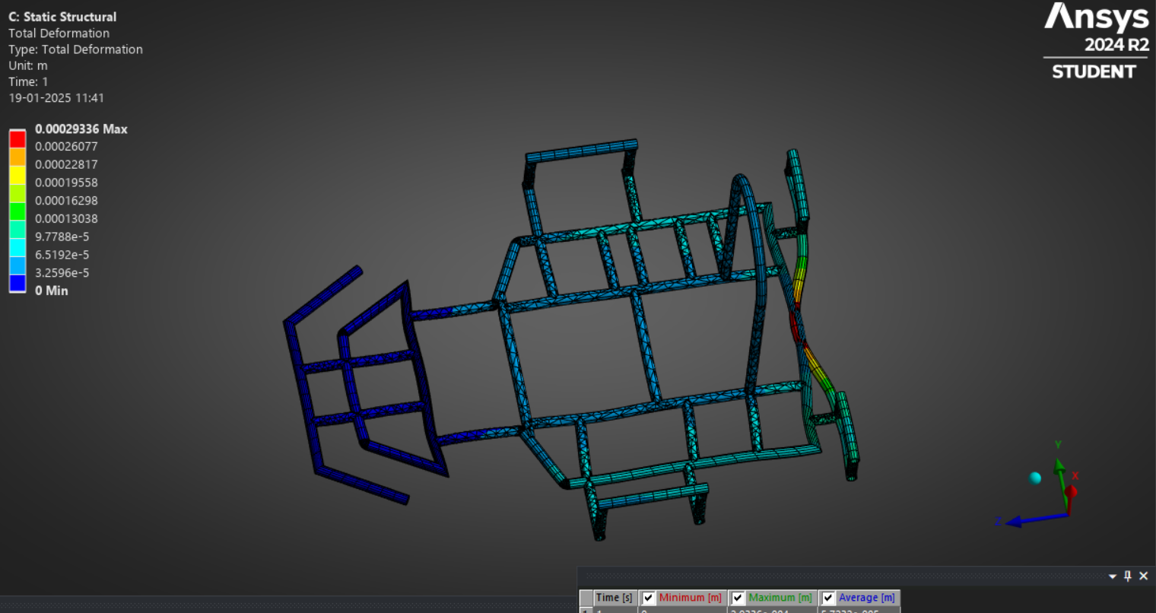
CHASSIS ANALYSIS
MATERIAL | SPECS
TYPE | AISI 4130
DENSITY | 7.85 g/cc
Front impact
Side impact
PROPERTIES
Yield Strength (Mpa) | 450
Tensile Strength (MPa) | 670
PROPERTIES | FRONT | REAR | SIDE
FOS | 2.14 | 2. 6387 | 3 . 1331
Rear impact

Slide 7
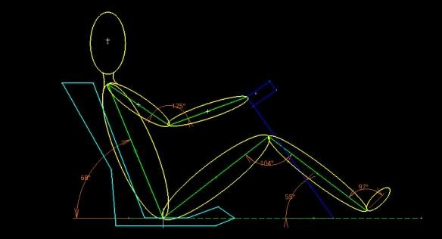
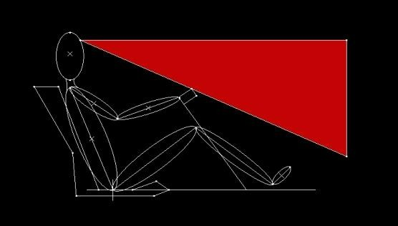
ERGONOMICS & SAFETY
Fig. Vision Cone
Fig. Driver Sitting Layout
Ergonomic considerations
Comfort for the User
Reducing the physical work load
Improving working postures
Making the handling of machine levers and controls easy
Increasing safety
Safety considerations
Kill switches( brake over travel, external access, drivers cockpit)
Fire extinguisher
Dot rated helmet
SFI rated driver’s suit
Gloves, shoes, neck support

Slide 8
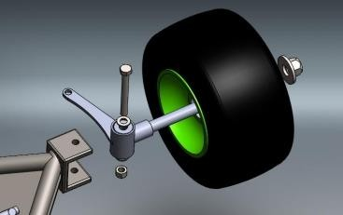
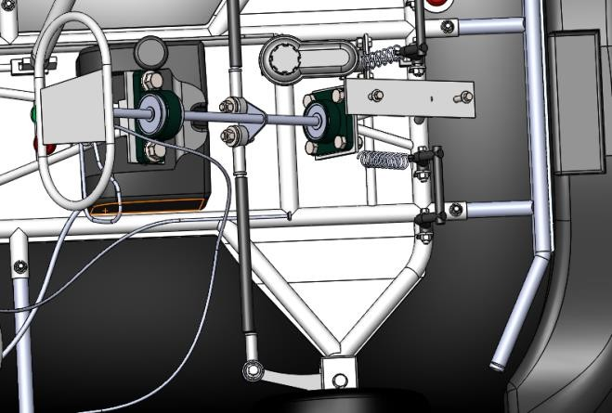
STEERING SYSTEM
Steering Parameter | Respective Values
Steering Wheel Radius | 5 inch
Mechanical Linkage Ratio | 10:1
Ackerman Percentage | 37.5
Ackerman Angle | Inside = 21 ° Outside =59 °
Turning Radius | 1.7m
Lock To Lock Distance | -230° to +230°
Fig. Front wheel assembly
Inside Angle | Outside Angle | Turning Radius
10° | 9.00° | 6.47 m
20° | 16.44° | 3.376 m
30° | 22.86° | 2.36 m
40° | 28.63° | 1.88 m
Fig. Steering System

Slide 9
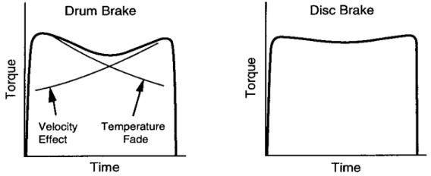
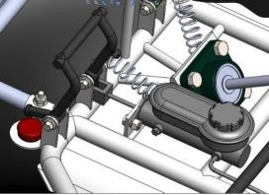
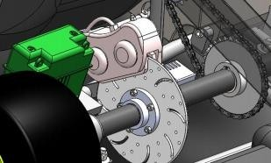
BRAKING SYSTEM
Parameters | Respective Values
Pedal Effort | 266.8 N
Leverage Ratio | 2:7
Master Cylinder Pressure | 4.13×10⁶ to 5.52×10⁶ N/m²
Caliper Force | 88.96 - 222.41 N
Clamping Force | 950 N
Disc Diameter | 200 mm
Disc Thickness | 4 mm
Brake Fluid Used | DOT 4
Height Of C.G. | 2 inches
Load Distribution | Front : 35% Rear : 75%
Fig. Disk vs. drum Graph
Speed | Stopping Distance | Stopping Time
30 Km/hr | 5.89 m | 1.41 sec
60 Km/hr | 23.57 m | 2.83 sec
70 Km/hr | 31.41 m | 3.26 sec
Fig : Braking system
Fig. Cad Model of Disc

Slide 10
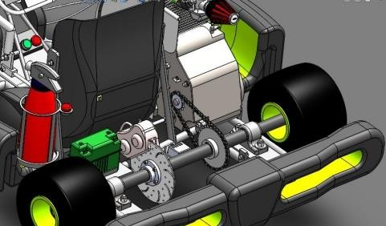
ENGINE & TRANSMISSION
SR. | Parameters | Respective Values
1. | Transmission Type | Manual Gear Box
2. | Final Drive Ratio | 1:2
3. | Driving Sprocket | 16 teeth
4. | Driven Sprocket | 32 teeth
SR. | Parameters | Respective Values
1. | Engine | Honda Unicorn 149.5cc
2. | Maximum Power | 14.5bhp @ 8000 rpm
3. | Maximum Torque | 14.6 Nm @ 6000 rpm
Gear | Gear Ratio | RPM At Axel | Torque In N-m | Power In KW
1 | 3 | 443 | 212.16 | 0.96
2 | 1.77 | 751 | 125.17 | 1.64
3 | 1.316 | 1010 | 93.06 | 2.22
4 | 1.045 | 1272 | 73.9 | 2.77
5 | 0.875 | 1519 | 61.8 | 3.31
Fig. Transmission System

Slide 11
WEIGHTS AND BOM / COSTING

Slide 12
DFMEA
COMPONENT | FUNCTION | POTENTIAL FAILURE MODE | POTENTIAL EFFECTS | S | POTENTIAL CAUSES | O | D | R.P.N. | ACTIONS TAKEN | S | O | D | R.P.N
BRAKES | Dissipate kinetic energy into heat | Leakage of fluid from brake line | Improper braking may cause accident | 7
 |  |  |  |  | Excessive fluid pressure | 5 | 4 | 140 | Use higher strength fluid lines | 7 | 4 | 2 | 84
 |  | Excessive pedal travel | Insufficient braking force | 6 | Low fluid in reservoir | 3 | 2 | 140 | Find out leakage and repair it | 6 | 4 | 2 | 48
 |  |  |  |  | Air trapped in system | 7 | 4 | 168 | Bleed the system and refill master cylinder | 6 | 3 | 4 | 72
KNUCKLE | Assist in steering | Variation in camber angle of both wheels | Tire may burst out | 9 | Improper positioning of knuckle | 8 | 9 | 648 | Set knuckle in proper position at same camber | 5 | 4 | 5 | 100
 |  | Excessive heating in knuckle assembly | Bearing failure leads to bursting out of tire | 9 | Proper placing of bearing | 8 | 9 | 648 | Proper bearing position | 5 | 4 | 5 | 100
PEDALS | For actuation of ACB | Constraints in pedal movement | Improper actuations in breaking & acceleration | 5 | Faulty placing at spring | 5 | 6 | 150 | Proper placing of spring | 8 | 3 | 2 | 48
 |  |  |  |  | Insufficient strength of spring | 5 | 7 | 175 | Select proper spring | 8 | 3 | 2 | 48
STEERING | To turn the vehicle/angular positioning of wheel | Steering hard to turn | Difficult to steer, may under steer | 4 | Low tire pressure | 9 | 1 | 36 | Proper sealing should be inspected | 6 | 4 | 1 | 24
 |  |  |  |  | Wheels are not properly aligned | 8 | 7 | 224 | Aligned wheel properly | 6 | 7 | 6 | 252
BATTERY | Provides electric energy | Discharge of battery | Failure of sub components runs on electric battery, brake light, starter | 7 | Reverse connection | 8 | 2 | 112 | Proper connections | 7 | 5 | 2 | 70
 |  |  |  |  | Excessive use | 8 | 1 | 56 | Keep running battery charging source | 7 | 1 | 2 | 14
TRANSMISSION | Transmit engine power to axle | Outward shaft of turn | Vehicle stop moving | 9 | Improper selection of sprocket wheel | 4 | 8 | 288 | Select proper sprocket wheel | 4 | 4 | 2 | 32
 |  |  |  |  | Inadequate lubrication | 6 | 2 | 108 | Provide lubrication in proper time period | 4 | 6 | 1 | 24

Slide 13
DESIGN VALIDATION
Sr no. | Parameter | Method of Checking | Design Value
1 | Wheel base | Distance from center of front wheel to center of rear wheel using measuring tape | 40 inch
2 | Wheel track | Minimum distance between center of both front wheels or rear wheels using measuring tape | 38 inch
3 | Weight | Weight of vehicle without driver and dry fuel tank measuring on weighing machine | 120 kg
4 | Turning radius | Radius of circle when steering wheel locked at full travel | 1.7 m
5 | Ackerman angles | Vehicle with steering wheel locked at full travel and angle between initial and final position. | Inside angle =40° Outside angle =28.63°
6 | Top speed | Max. rpm of engine*gear ratio*0.1047*radius of wheel | 70 km/hr
7 | Stopping distance | (top speed)^2 / (2*acceleration) | 30.79m @68km/hr
8 | Stopping time | (top speed)/ deceleration | 3.2 sec
9 | Deceleration | F= ma | 6.86 m/s²

Slide 14
GANTT CHART
Sr. No. | Task | Task Lead | Start | End | Duration (Days) | % Complete | Working Days
1. | Development | Pradeep M | 15/04 | 18/04 | 4 | 100 | 4
2. | Formation |  | 19/04 | 26/04 | 7 | 100 | 7
3. | Registration |  | 15/09 | 15/09 | 1 | 100 | 1
4. | Department Distribution |  | 05/05 | 05/05 | 1 | 100 | 1
5. | Basic Understanding |  | 01/06 | 05/06 | 5 | 100 | 5
6. | Market Survey | Sakthivel V | 12/06 | 30/06 | 19 | 100 | 19
7. | Cost Report | Guru Prasanna V | 03/07 | 03/07 | 3 | 100 | 3
8. | Calculations | Harjendra D S
9. | Rulebook Analysis & Calculations | Prakesh | 10/07 | 14/07 | 5 | 100 | 5
10. | Chassis 3D Design |  | 15/07 | 24/07 | 10 | 100 | 10
11. | Chassis Analysis & Final Design |  | 25/07 | 09/08 | 15 | 100 | 15
12. | Final Report | Harjendra D S | 10/08 | 24/08 | 15 | 100 | 15
13. | Material | GokulNath S | 04/09 | 11/09 | 7 | 100 | 7
14. | Manufacturing | Anish | 25/09 | 03/11 | 40 | 100 | 40
15. | Testing & Modification | Prithiv Raj V | 01/12 | 20/12 | 20 | 100 | 20
16. | Prerace |  | 22/12 | - | - | - | -

Slide 15
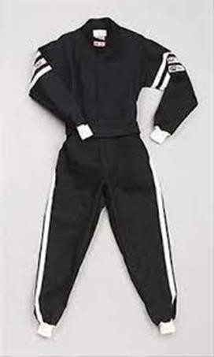
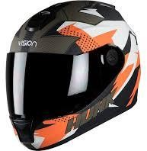
SAFETY FEATURES

Slide 16


